Slide 1
RAG

Slide 2
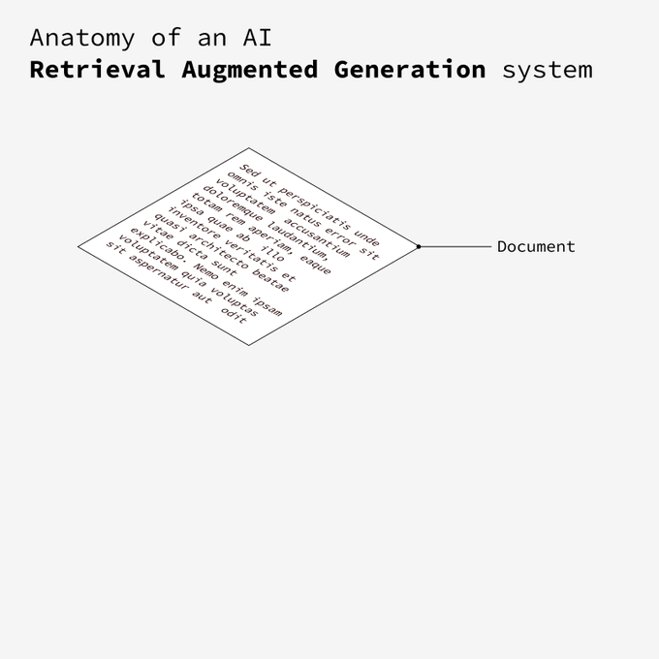
Author: https://github.com/baptadn
Notes:
It all starts with a document

Slide 3
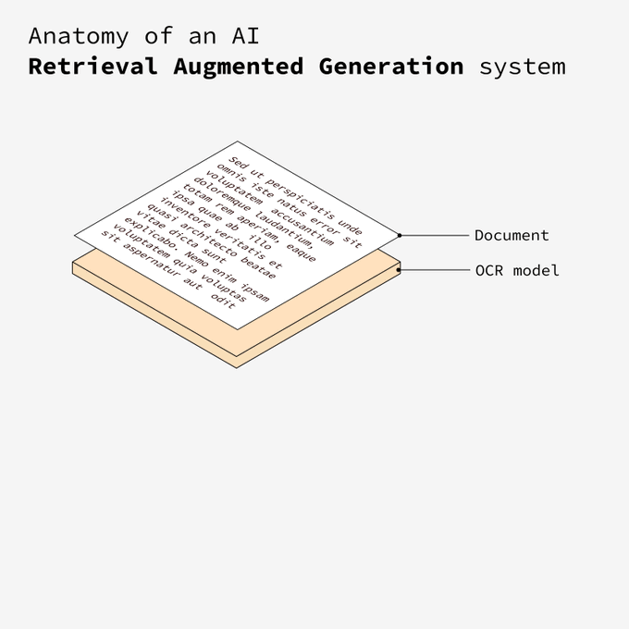
Notes:
Next, the document is processed by an OCR (Optical Character Recognition) model. This model extracts the text if needed.

Slide 4
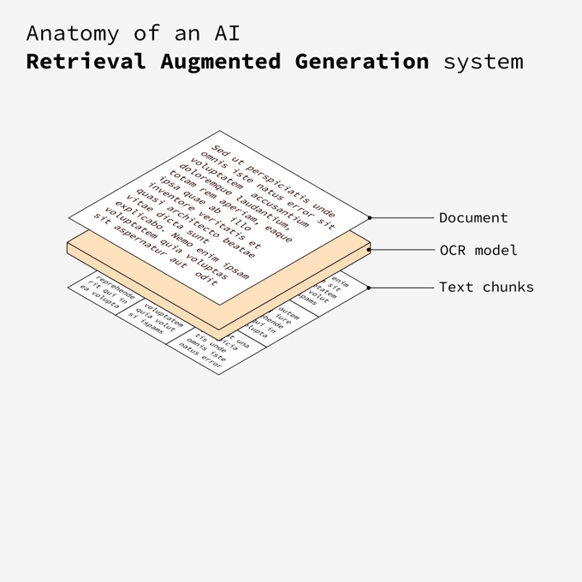
Notes:
The text is broken down into smaller, manageable pieces. This chunking allows for more efficient processing and analysis in the later stages.

Slide 5
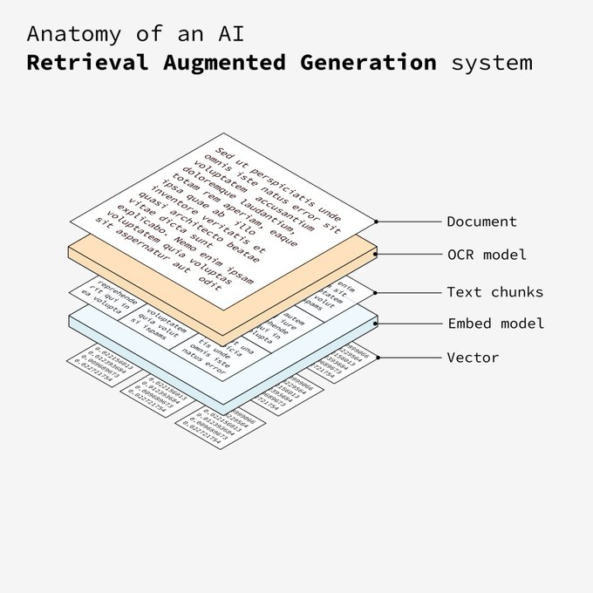
Each text chunk is then passed through an embed model. This model converts the chunks into vectors, numerical representations that capture the semantic meaning of the text.
Notes:
Each text chunk is then passed through an embed model. This model converts the chunks into vectors, numerical representations that capture the semantic meaning of the text.

Slide 6
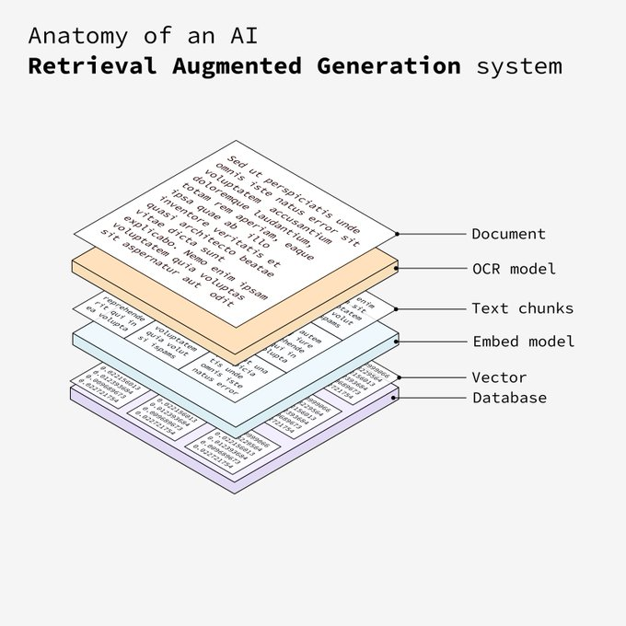
Notes:
The vectors are stored in a vector database. This database allows the system to efficiently retrieve relevant information based on semantic similarity.

Slide 7
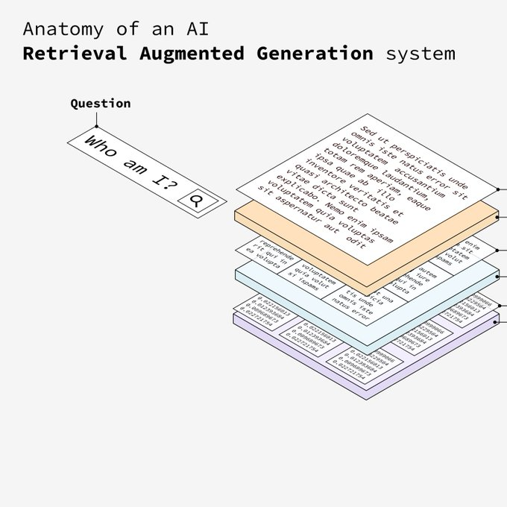
Notes:
The user inputs a question into the system. This question will be used to retrieve the most relevant information from the vector database.

Slide 8
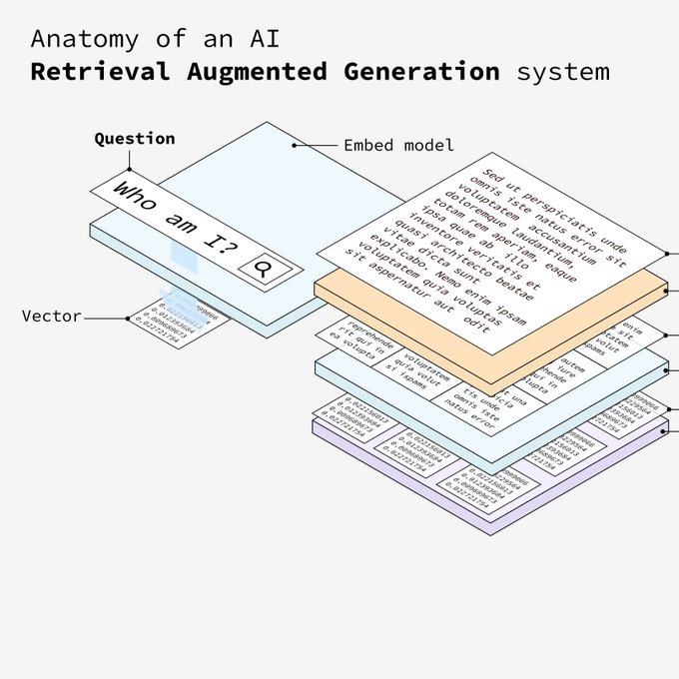
Notes:
The question is embedded using the same embed model that processed the text chunks. This ensures that both the question and the text chunks are in the same vector space.

Slide 9
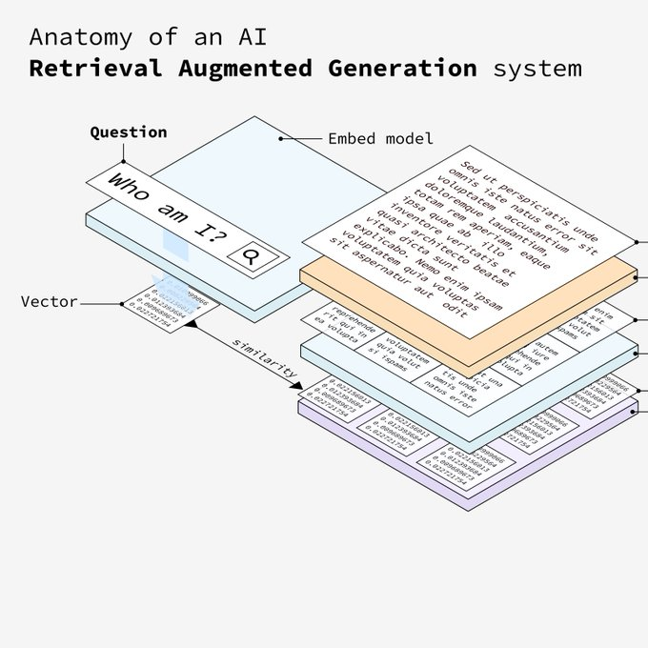
Notes:
The embedded question is matched against the vectors in the database based on similarity. The most similar vectors (text chunks) are retrieved.

Slide 10
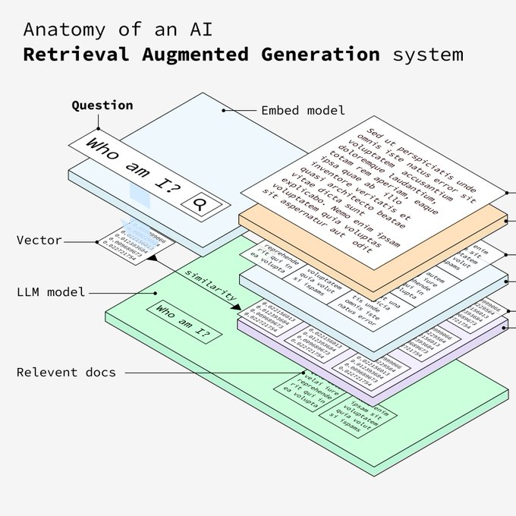
Notes:
The system retrieves the most relevant documents based on the similarity scores. The LLM processes the relevant information to formulate a detailed answer to the user’s question.

Slide 11
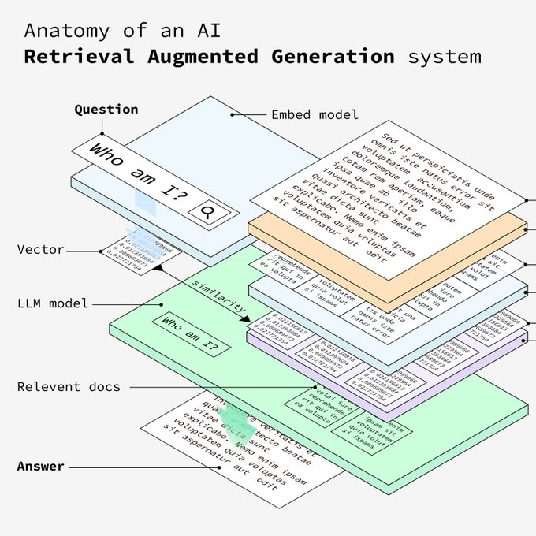
Notes:
The final answer is presented to the user. This answer is generated from the most relevant information retrieved from the document, ensuring accuracy and relevance.

Slide 12


Slide 13
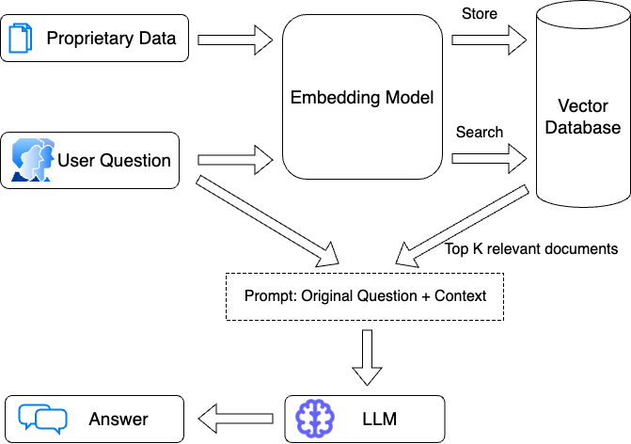
https://blog.langchain.dev/query-transformations/
Notes:
https://blog.langchain.dev/query-transformations/

